Slide 1


Slide 2
Evaluate A Casualty Task #081-831-1000

Slide 3
Conditions
You have a casualty who has signs and/or symptoms of an injury.
Note : When evaluating and/or treating a casualty, seek medical aid as soon as possible. Do not stop treatment. Send another person to find medical aid.

Slide 4
Standards
Evaluate the casualty following the correct sequence.
All injuries and/or conditions were identified.
The casualty was immobilized if a neck or back injury was suspected.
  Note: If a broken neck or back is suspected, do not move the casualty unless to save his life.

Slide 5
WARNING
If there are signs of chemical or biological agent poisoning, immediately mask the casualty. If it is not nerve agent poisoning, decontaminate exposed skin and gross contamination of the clothing or over garments. If nerve agent poisoning, administer the antidote before decontamination (See Task 081-831-1044)

Slide 6
Performance Steps
Check for :
Responsiveness
Breathing
Bleeding
Shock
Fractures
Burns
Head Injury

Slide 7
Check for Responsiveness
Ask in a loud, but calm voice, “Are you okay?”
Gently shake or tap the casualty on the shoulder.
Watch for a response. If the casualty does not respond, go to the next step(Breathing)
If the casualty is conscious, ask where he feels different than usual or where it hurts. Go to the next step(Bleeding).
If the casualty is conscious but is choking and cannot talk, stop the evaluation and begin treatment. (See Task 081-831-1003)

Slide 8
Check for Breathing
Look for rise and fall of the casualty’s chest.
Listen for breathing by placing your ear about one inch above the casualty’s mouth and nose.
Feel for breathing by placing your hand or cheek about one inch above the casualty’s mouth and nose. If the casualty is not breathing, stop the evaluation and begin treatment. ( See Task 081-831-1042)
  Note:
  Check for pulse during mouth-to-mouth resuscitation, as necessary.

Slide 9
Check for Bleeding
Look for spurts of blood or blood-soaked clothes.
Look for entry and exit wounds.
If bleeding is present, stop the evaluation and begin treatment as appropriate

Slide 10
WARNING
In a chemically contaminated area, do not expose the wounds

Slide 11
Check for Shock
Look for any of the following signs and/or symptoms.
  Sweaty but cool skin ( clammy skin)
  Paleness of skin
  Thirst
  Loss of blood
  Confusion
  Faster than normal breathing rate
  Blotchy or bluish skin, especially around the mouth
  Nausea and/or vomiting
  If signs or symptoms of shock are present, stop the evaluation and begin treatment(See Task 081-831-1005)

Slide 12
WARNING
Leg fractures must be splinted before elevating the legs for shock.

Slide 13
Check for Fractures
Look for the following signs and symptoms of a back or neck injury.
  Pain or tenderness of the neck or back area.
  Cuts or bruises in the neck or back area.
  Inability of the casualty to move (paralysis or numbness)
    Ask about the ability to move(paralysis)
    Touch the casualty’s arms and legs; ask whether he can feel your hand(numbness)

Slide 14
WARNING
  Unless there is immediate life threatening danger, do not move a casualty whom you suspect has a back of neck injury.

Slide 15
Fractures cont.
Immobilize any casualty suspected of having a neck or back injury by doing the following:
  Tell the casualty not to move
  If a back injury is suspected, place padding under the natural arch of the casualty’s back

Slide 16
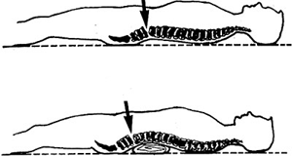
Fractures cont.
Back Injury
Padding

Slide 17
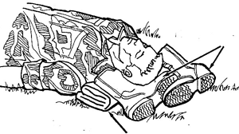
Fractures cont.
If a neck injury is suspected, place a roll of cloth under the casualty’s neck and put boots filled with dirt or rocks on both sides of the head.

Slide 18
Fractures cont.
Check the casualty’s arms and legs for open or closed fractures
  Check for open fractures
    Look for bleeding
    Look for bone sticking through the skin

Slide 19
Fractures cont.
  Check for closed fractures
    Look for swelling
    Look for discoloration
    Look for deformity
    Look for unusual body position
    Note:
    If a fracture to an arm or a leg is suspected, stop the evaluation and begin treatment.

Slide 20
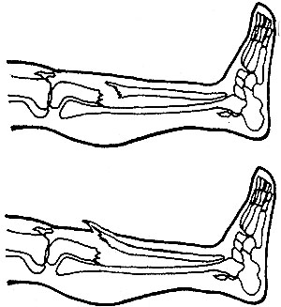
Fractures cont.
Closed Fractures
Open Fractures

Slide 21
Check for Burns
Look carefully for reddened, blistered, or charred skin. Also check for singed clothes
If burns are found, stop the evaluation and begin treatment.( See Task 081-831-1007)

Slide 22
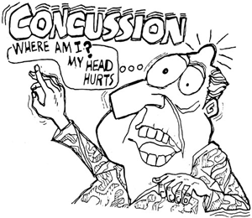
Check for Head Injury
Look for the following signs and symptoms
    Unequal pupils
    Fluid from the ears, nose, mouth, or injury site
    Slurred speech
    Dizziness
    Sleepiness
    Headache
    Confusion

Slide 23
Head Injury cont.
  Loss of memory or consciousness
    Staggering in walking
    Vomiting
    Paralysis
    Convulsions or twitches
    Note:
    If a head injury is suspected, continue to watch for signs that would require mouth-to-mouth resuscitation, treatment for shock, or control bleeding

Slide 25
Brief the Soldier
Do in order all the necessary steps to evaluate the casualty and identify all wounds and/or conditions. Be able to tell me what first aid action he would take, but that no aid is to be performed unless a neck or back injury is found.

Slide 26
Break

